Slide 1
Facade
Provide a unified interface to a set of interfaces in a subsystem. Facade defines
a higher-level interface that makes the subsystem easier to use.

Slide 2
Motivation
Structuring a system into subsystems helps reduce complexity.
A common design goal is to minimize the communication and dependencies between subsystems.
One way to achieve this goal is to introduce a facade object that provides a single, simplified interface to the more general facilities of a subsystem.

Slide 3
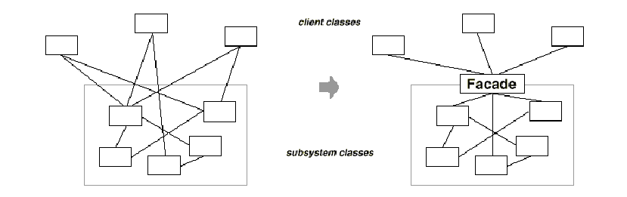
Motivation

Slide 4
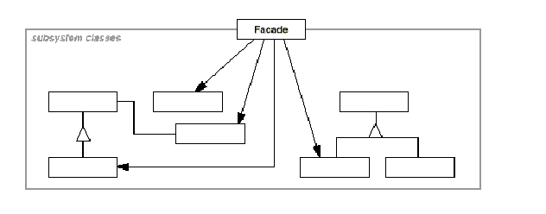
Structure

Slide 5
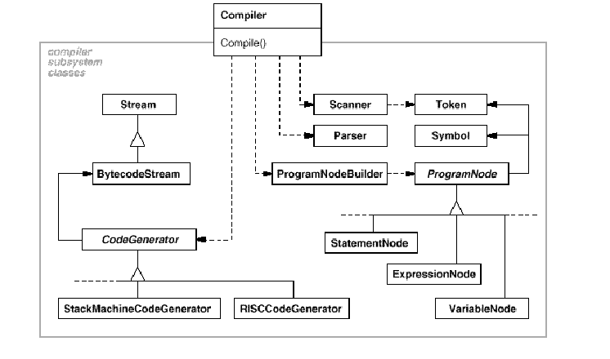
A programming environment that gives applications access to its compiler subsystem

Slide 6
Participants
Facade (Compiler)
  knows which subsystem classes are responsible for a request.
  delegates client requests to appropriate subsystem objects.
Subsystem classes (Scanner, Parser, ProgramNode, etc.)
  Implement subsystem functionality.
  handle work assigned by the Facade object.
  have no knowledge of the facade; that is, they keep no references to it.

Slide 7
Use the Facade pattern when
you want to provide a simple interface to a complex subsystem.
there are many dependencies between clients and the implementation classes of an abstraction. Introduce a facade to decouple the subsystem from clients and other subsystems, thereby promoting subsystem independence and portability.

Slide 8
Use the Facade pattern when
you want to layer your subsystems. Use a facade to define an entry point to each subsystem level.

Slide 9
Related Patterns
Abstract Factory can be used with Facade to provide an interface for creating subsystem objects in a subsystem-independent way.
Usually only one Facade object is required. Thus Facade objects are often Singletons.

Slide 10
Example
The Façade pattern deals with a subsystem of classes.
A subsystem is a set of classes that work in conjunction with each other for the purpose of providing a set of related features (functionality).
For example, an Account class, Address class and CreditCard class working together, as part of a subsystem, provide features of an online customer.

Slide 11
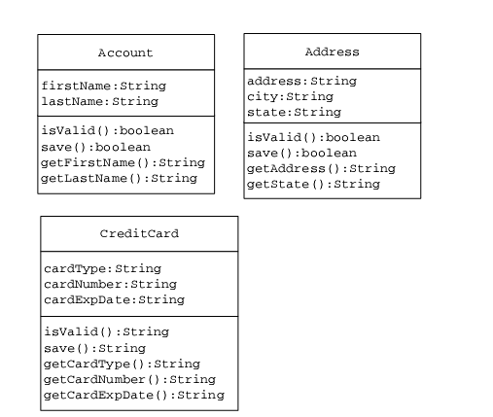
Subsystem classes

Slide 12
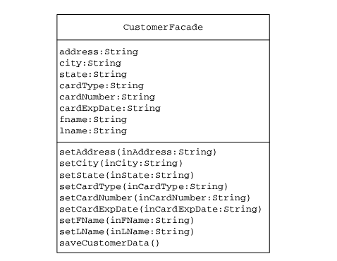
Façade class to be used by the client

Slide 13
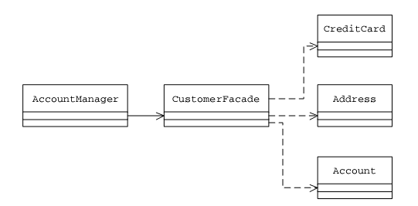
Class Association with Facade

Slide 14
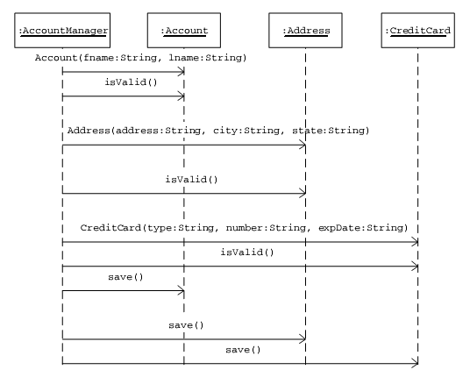
Sequence Diagram (without façade)

Slide 15
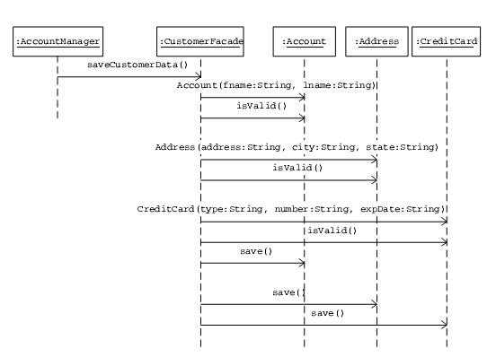
Sequence Diagram (with façade)

Slide 16
Core J2EE Patterns – Session Facade
Context
Enterprise beans encapsulate business
logic and business data and expose their
interfaces, and thus the complexity of the
distributed services, to the client tier.

Slide 17
Problem
In a multi-tiered Java 2 Platform, Enterprise
Edition (J2EE) application environment, the
following problems arise:
Tight coupling, which leads to direct dependence between clients and business objects;
Too many method invocations between client and server, leading to network performance problems;
Lack of a uniform client access strategy, exposing business objects to misuse.

Slide 18
Solution
Use a session bean as a façade to encapsulate
the complexity of interactions between the
business objects participating in a workflow.
The session façade manages the business
objects, and provides an uniform coarse-grained
service access layer to clients.

Slide 19
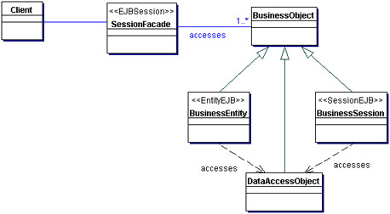
Session Façade

Slide 20
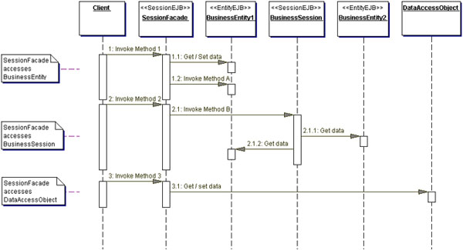

Slide 21
using System;
namespace
DoFactory.GangOfFour.Facade.Structural
{
class MainApp
{
public static void Main()
{
Facade facade = new Facade();
facade.MethodA();
facade.MethodB();
Console.ReadKey();
}
}

Slide 22
class SubSystemOne
{
public void MethodOne()
{
Console.WriteLine(" SubSystemOne Method");
}
}
class SubSystemTwo
{
public void MethodTwo()
{
Console.WriteLine(" SubSystemTwo Method");
}
}

Slide 23
class SubSystemThree
{
public void MethodThree()
{
Console.WriteLine(" SubSystemThree Method");
}
}
class SubSystemFour
{
public void MethodFour()
{
Console.WriteLine(" SubSystemFour Method");
}
}

Slide 24
class Facade
{
private SubSystemOne _one;
private SubSystemTwo _two;
private SubSystemThree _three;
private SubSystemFour _four;
public Facade()
{
_one = new SubSystemOne();
_two = new SubSystemTwo();
_three = new SubSystemThree();
_four = new SubSystemFour();
}

Slide 25
public void MethodA()
{
Console.WriteLine("\nMethodA() ---- ");
_one.MethodOne();
_two.MethodTwo();
_four.MethodFour();
}
public void MethodB()
{
Console.WriteLine("\nMethodB() ---- ");
_two.MethodTwo();
_three.MethodThree();
}
}
}

Slide 26
Output
MethodA() ----
SubSystemOne Method
SubSystemTwo Method
SubSystemFour Method
MethodB() ----
SubSystemTwo Method
SubSystemThree Method

